Slide 1




Plant disease segmentation project
(group-6)
Contributors:
Nirvik Shaha Rudra (21201241)
Md. Mubashirul Islam(21201428)
Shuddha Sourav Prachi(21201429)
Md Abrar Uddin (21301159)

Slide 2
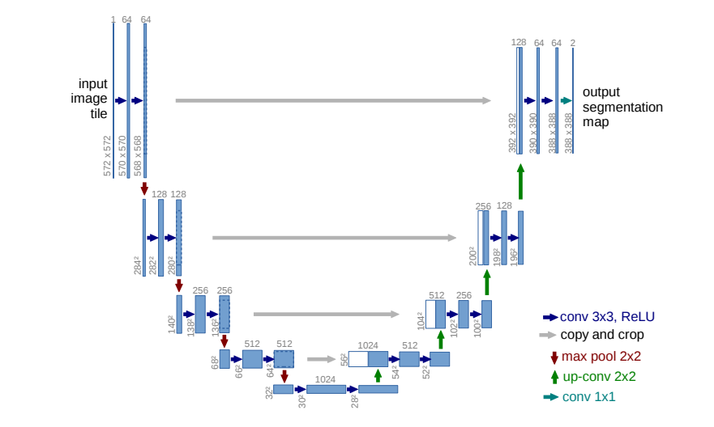
Model Architecture

Slide 3
Evaluation Results
Train mIoU: 0.5937, Dice: 0.7034, Accuracy: 0.9288
Validation mIoU: 0.4698, Dice: 0.5881, Accuracy: 0.8751
Test mIoU: 0.4757, Dice: 0.5923, Accuracy: 0.8726

Slide 4
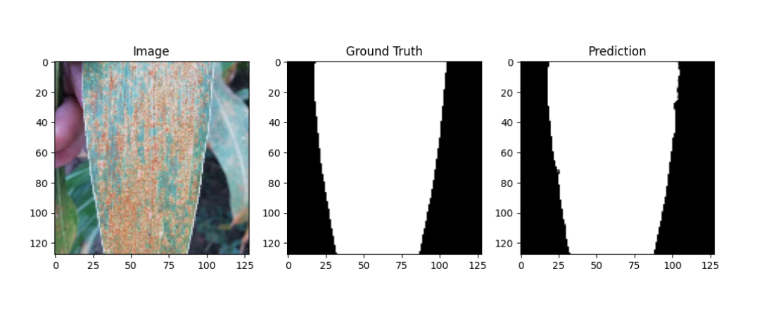
Good segmentation examples

Slide 5
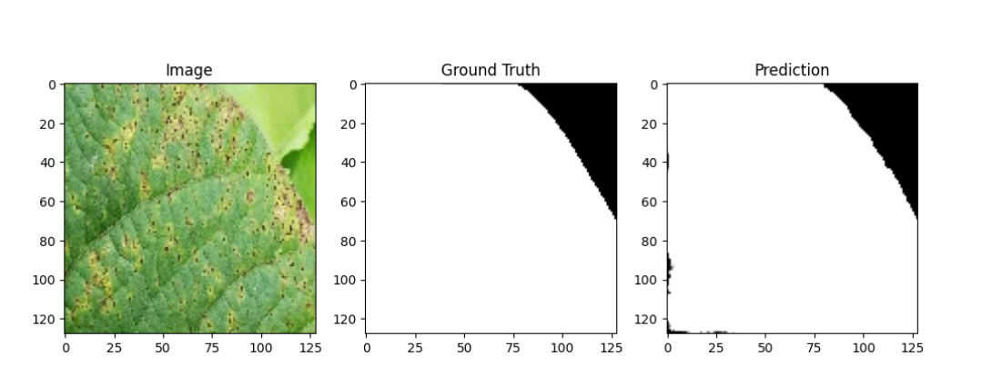
Good segmentation examples

Slide 6
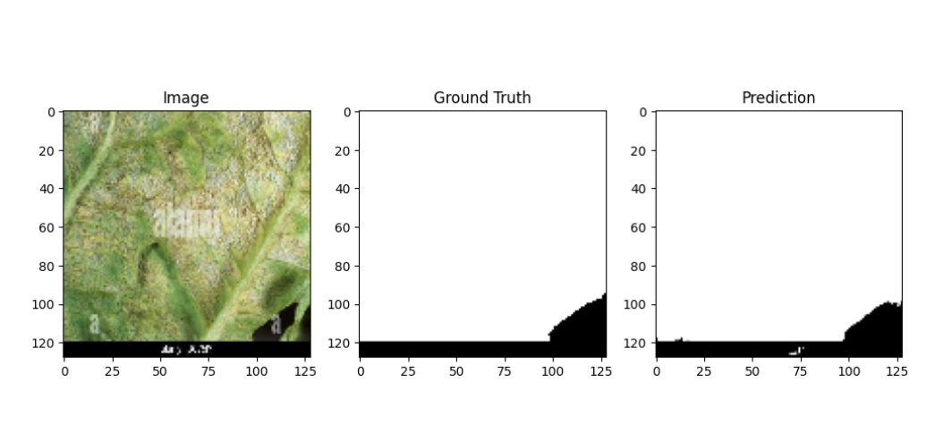
Good segmentation examples

Slide 7
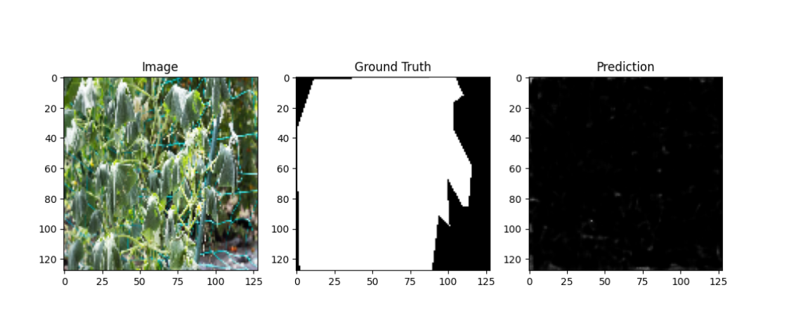
Bad segmentation example

Slide 8
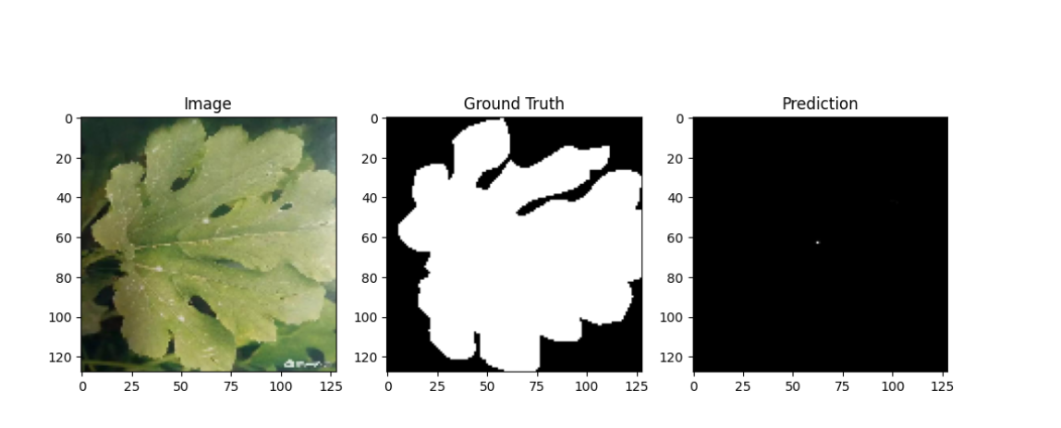
Bad segmentation example

Slide 9
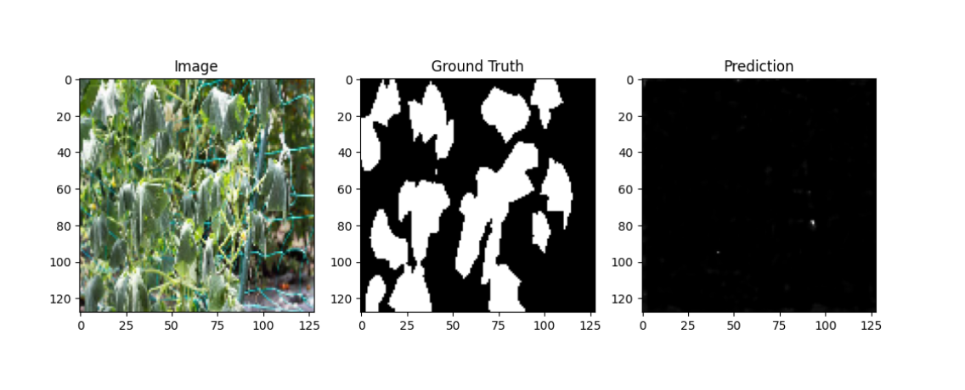
Bad segmentation example

Slide 10
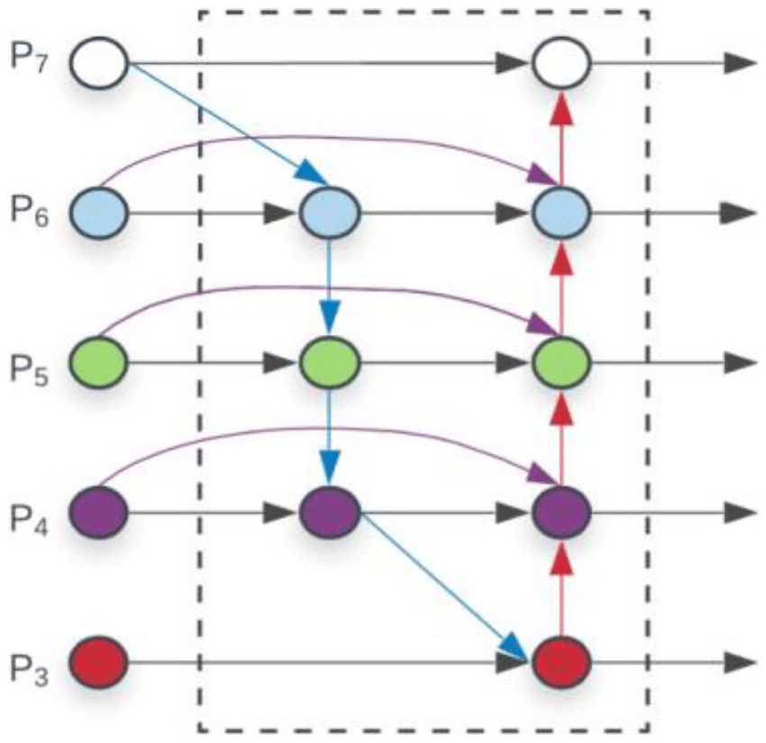
Bifpn Model Architecture

Slide 11
Evaluation Results of Unet with Bifpn
Train - mIoU: 0.3824, Dice: 0.4971, Accuracy: 0.8581
Validation - mIoU: 0.3570, Dice: 0.4687, Accuracy: 0.8534
Test - mIoU: 0.3623, Dice: 0.4736, Accuracy: 0.8513

Slide 12
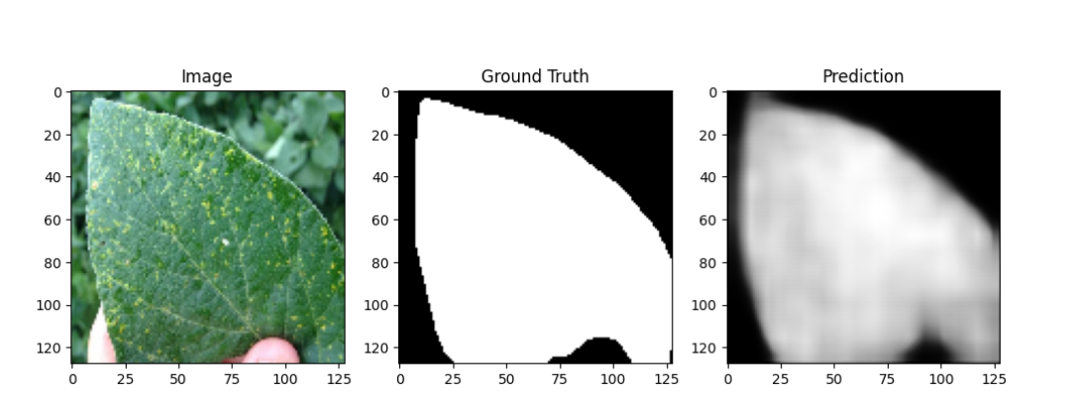
Good segmentation examples

Slide 13
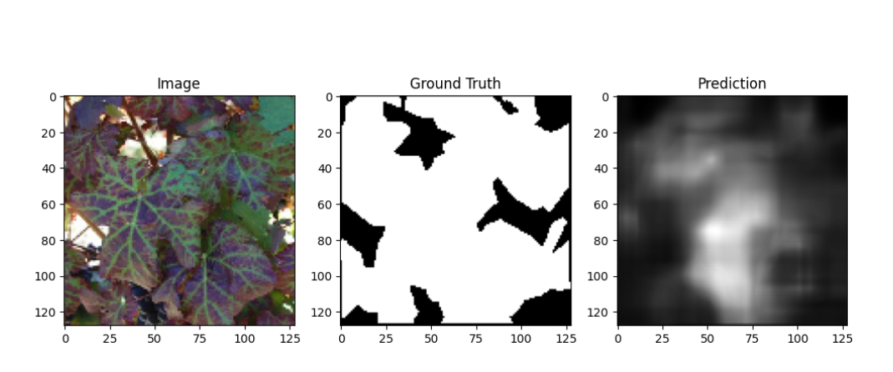
Bad segmentation example

Slide 14
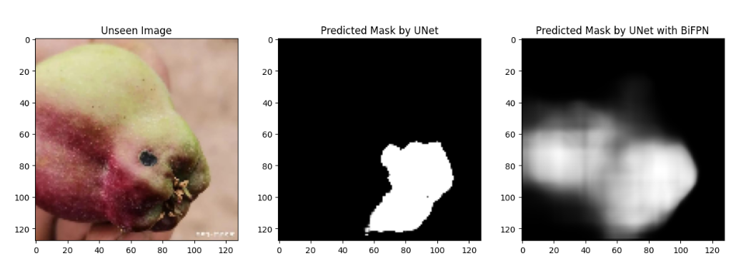
Output comparison between both model

Slide 15
Thank
You

